Slide 1
Feedback

Slide 2
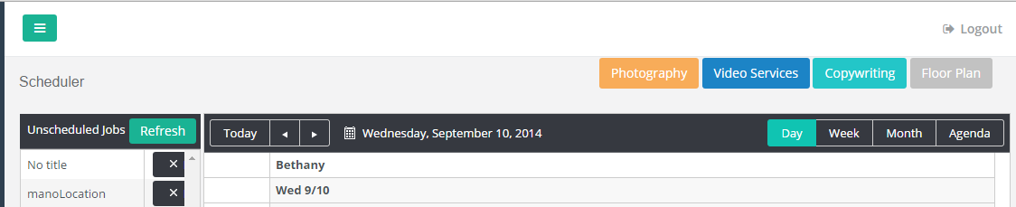
Alignment of this section looks sloppy.

Slide 3
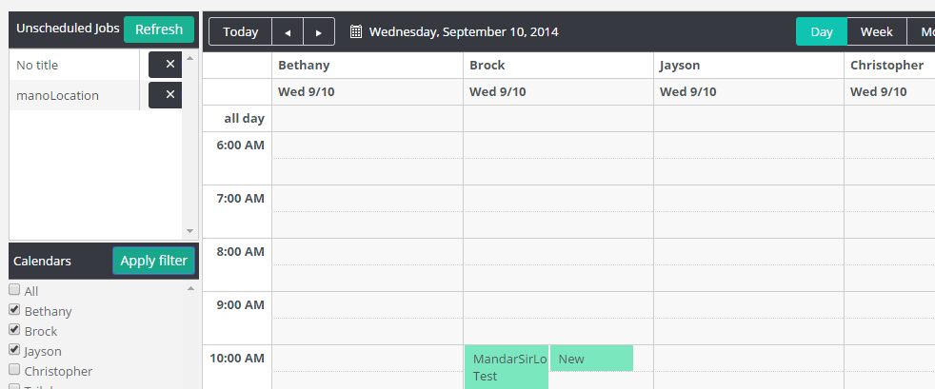
Can we show the First Name, Last Name for the calendars. I can see an issue when more than one user shares the same first name.

Slide 4
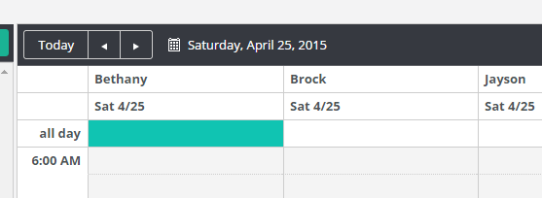
Data Retrieval. So It seems you are retrieving all event data for the selected calendars. Wouldn’t it make sense to break this up based on the a predefined date range and query again when outside of the existing data set. This is going to be a bottle neck when we link up production accounts.

Slide 5

Performance when clicking these product Groups is slow. This should be the same performance as selecting one or more calendars from the list and pressing apply filter.

Slide 6
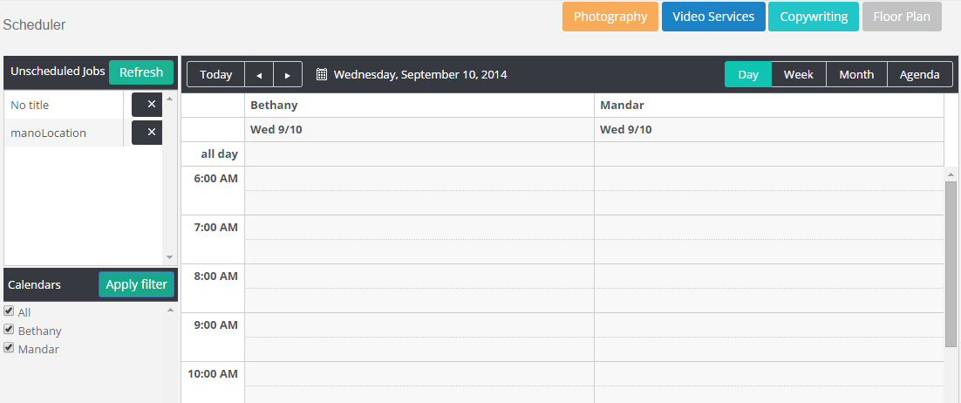
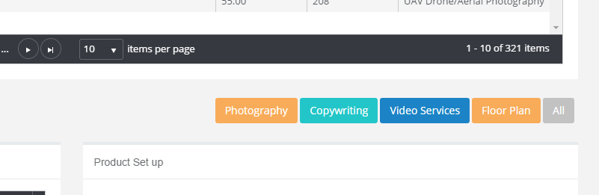
If click the product group buttons you are constraining the list of Calendars. You should only need to show all calendars in the list but apply the checkbox to those calendars associated with the product group. There should be a product group button for All like we have on the Product Page..

Slide 7
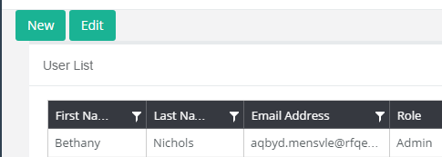
The alignment of these buttons lacks design.

Slide 8
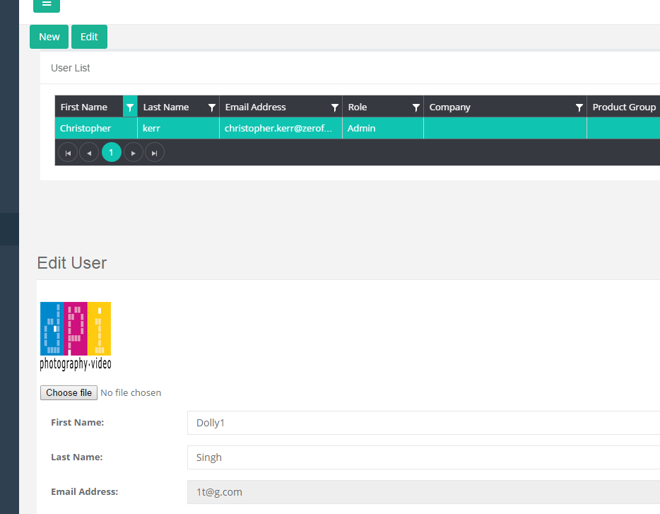
1. Alignment doesn’t look good. 2. If the user moves of the selected user record in the list, the Edit view doesn’t update.

Slide 9
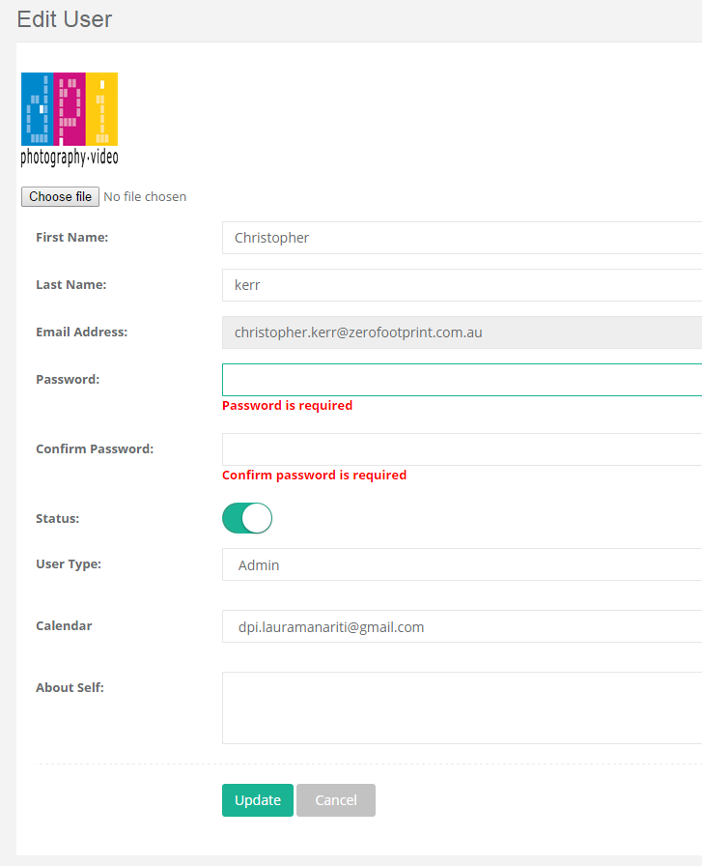
1. If the user attempt to change the calendar for a selected user, it asks the user to set password. This should only be required if the user attempts to change the password. Show a masked field for password/confirm password fields to show that a password is actually defined.. 2. Remove the About Self field from the UI.

Slide 10
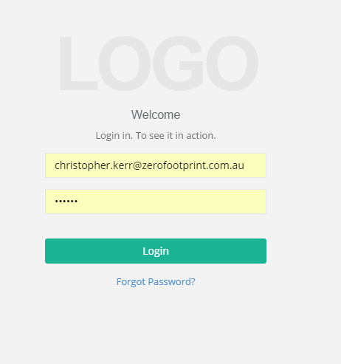
Apply the DPI logo here.

Slide 11
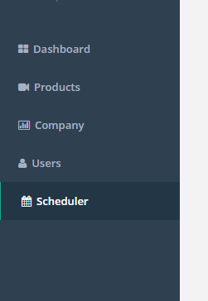
Hide the Dashboard menu item until complete.

Slide 12
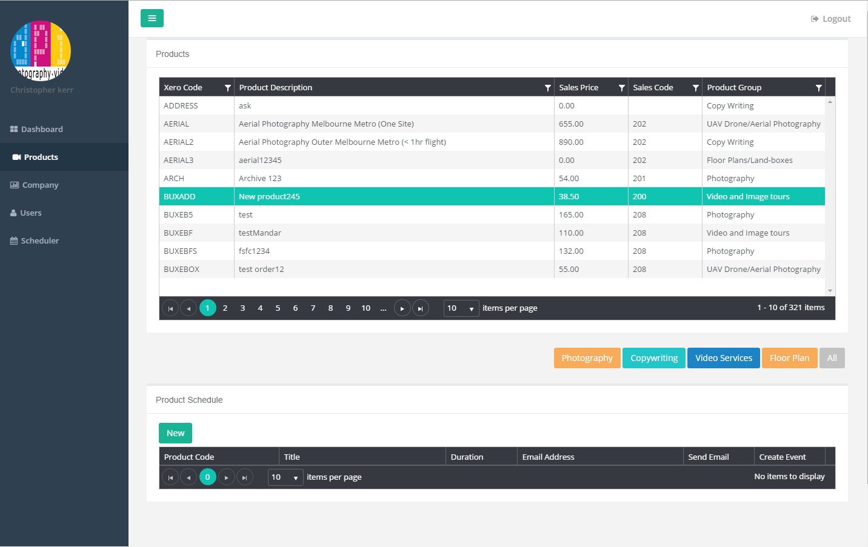
When the Product page load, why does the Product Schedule module load before the others. Can we show a progress icon for loading.

Slide 13
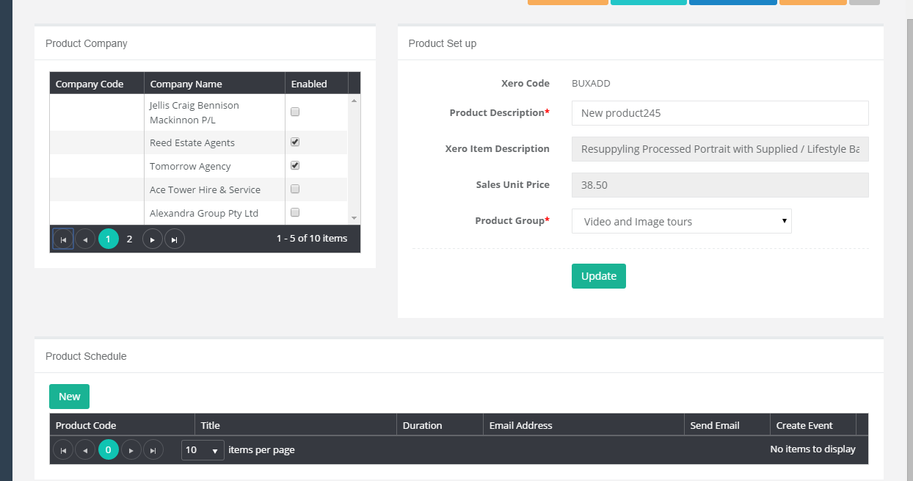
Can we have this as a fixed height.

